Slide 1
Biblio
Dan Crankshaw
Cain Lu
Paul O’Neill
Jiefeng Zhai

Slide 2
Agenda
Overview
Database Code
Typical Workflow
Demo
Searching Code

Slide 3
Motivation
Strange File Names
Music libraries, so why not text-based libraries?
Non-hierarchical relationships
Organize and view in one application
Notes:
Can also say something about how this would specifically be helpful for academic papers (i.e. grad students and professors), as well as for anyone who has ever had to do a research paper using
Jstore or similar.
Also, some of the design motivation was to make it minimalistic and as easy to use as possible. In some cases, we are willing to sacrifice complex functionality for ease of use.

Slide 4
Overview
Organize and read text-based files
Organization centers around tags
Tags are non-hierarchical (think directed graph not file system tree)
Files and tags have a many-to-many relationship

Slide 5
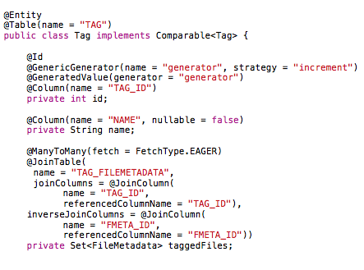
Hibernate

Slide 6
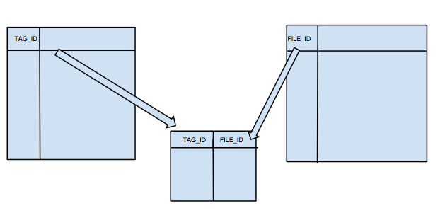
DB Schema

Slide 7
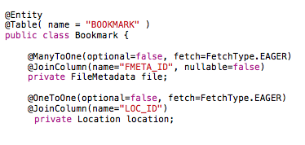
Hibernate

Slide 8
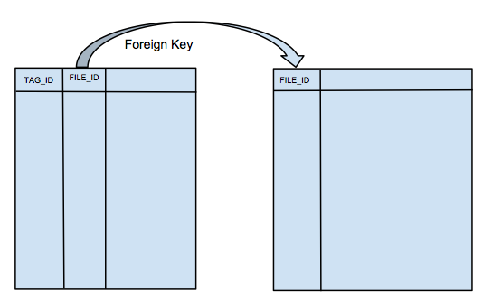
DB Schema

Slide 9
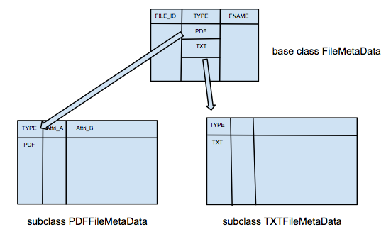
DB Schema

Slide 10
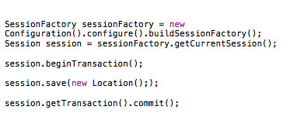
Accessing the DB

Slide 11
Workflow
User has a set of criteria (tags) in mind
Searches for each tag
Builds a set of tags
Filters by selected tags to get the intersection of files tagged by those tags and their children

Slide 12
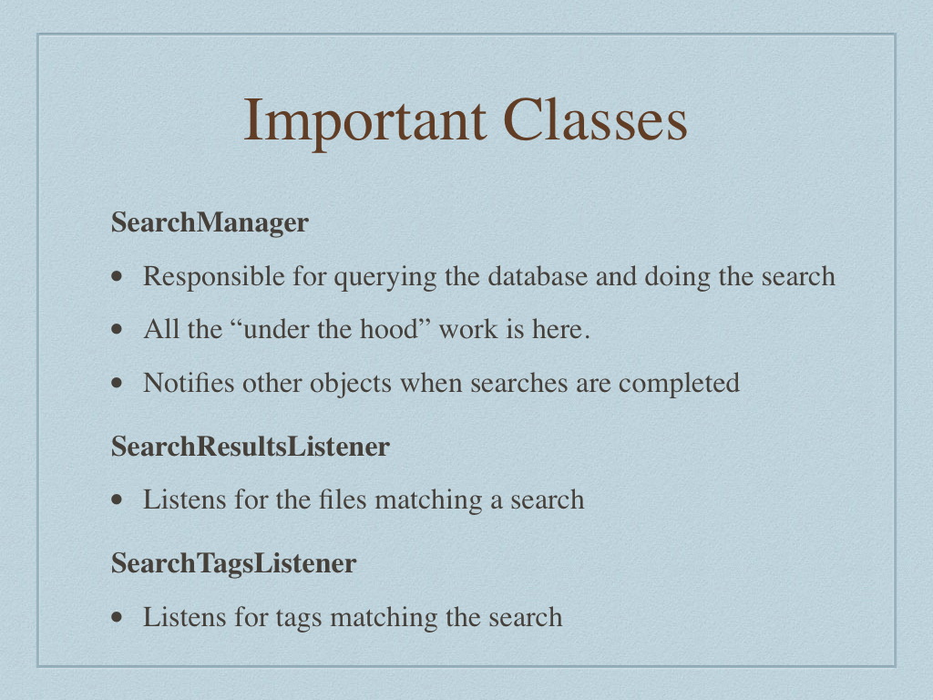

Slide 13
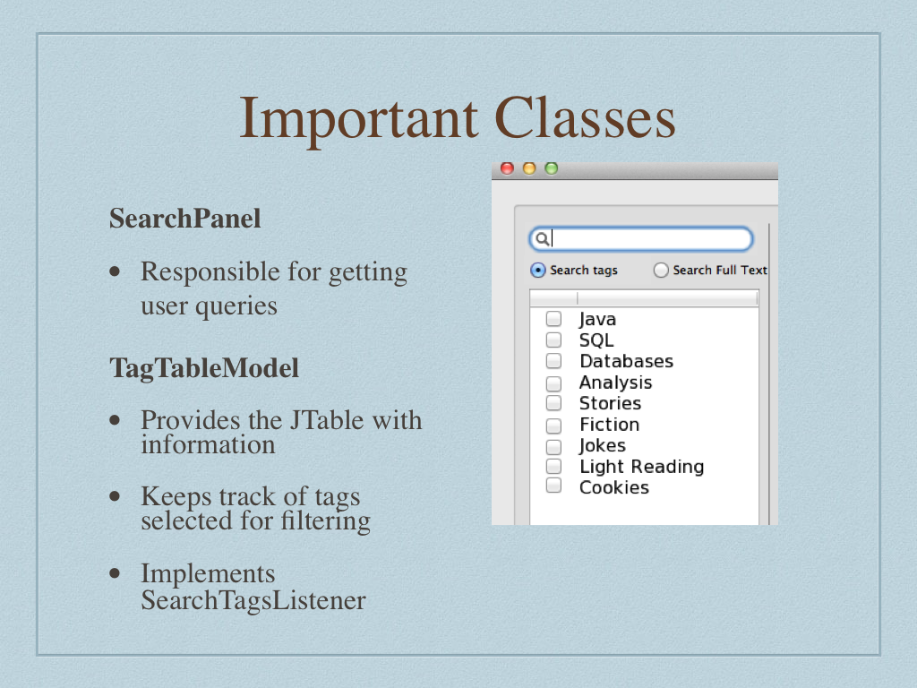

Slide 14
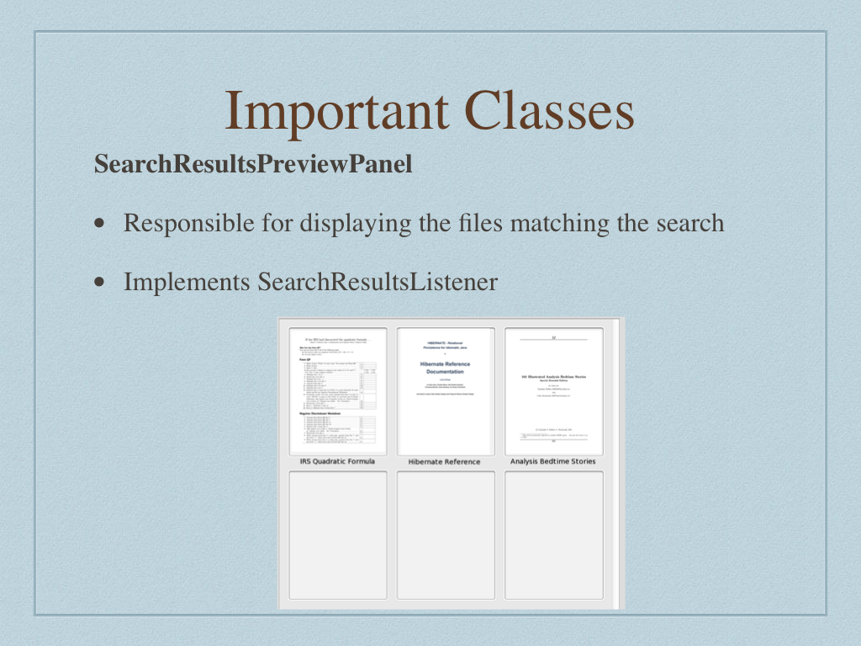

Slide 15
Demo!

Slide 16
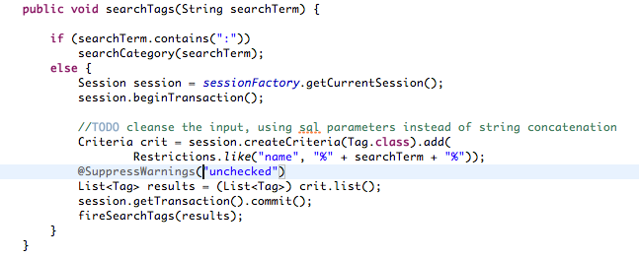
Search For Tag

Slide 17
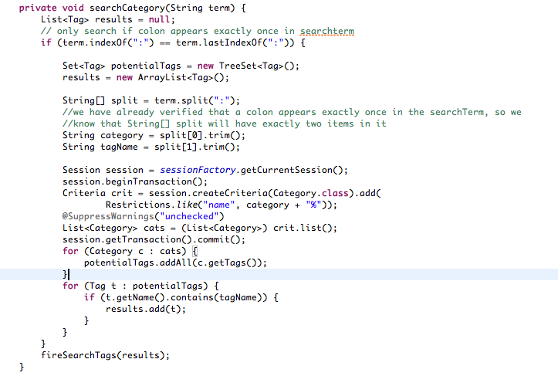
Search Tag in Category

Slide 18
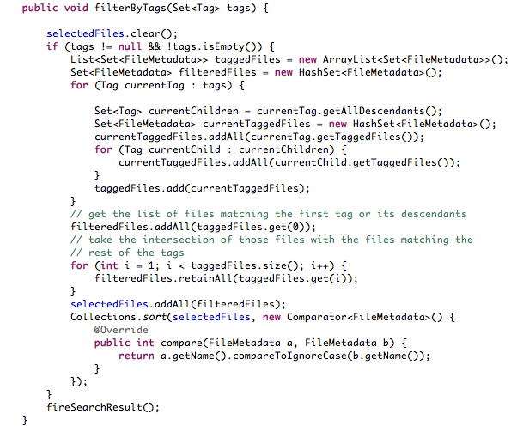
Filter by Tags

Slide 19
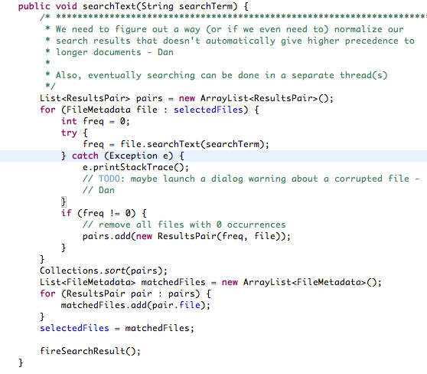
Full Text Search

Slide 20
Finishing Touches
Finish import support
RSS Reader
Expand to support EPUB
Add notes to files

